Slide 1
Ruby on Rails
Harish’s presentation on

Slide 2
Agenda
Introduction
What is Ruby
What is Rails
What is Ruby On Rails
Strings, Classes and Objects
Class Hierarchies and Attributes
Strings
Installation Process
Demo

Slide 3
introduction
ATDD (Acceptance Test Driven Development) This is process of a software development process in which testing is done initially and later on the developing is done based on the test results.
For this to achieve the Ruby on Rails is introduced on which the scripting is done according to the requirements from the clients.

Slide 4
What is Ruby?
Created in the year 1995 by Yukihiro Matsumoto, it is a dynamic, open source programming language with a focus on simplicity and productivity. It has an elegant syntax that is natural to read and easy to write.
It is an object Oriented programming language.
It is similar to Perl or Python.

Slide 5
Rails
What is Rails?
Rails is a web application development framework written in the Ruby language.
It allows you to write less code while accomplishing more than many other languages and frameworks.
It doesn’t allow you to repeat the code that you have already written, instead is called through functions or in built methods.

Slide 6
Ruby on Rails
What is Ruby on Rails?
The framework that is present on the server side web application, written in Ruby.
It needs an MIT license that is originating from the Massachusetts Institute of Technology.

Slide 7
Class Hierarchies and Methods
Ruby language has classes and methods.
When creating a class hierarchy, the classes with the most generalized behavior are higher up the hierarchy than classes with more specialist behavior. So a Thing class with just a name and a description, would be the ancestor of a Treasure class which has a name, a description and, additionally, a value.
The diagram on the next slide explains this concept in detail.

Slide 8
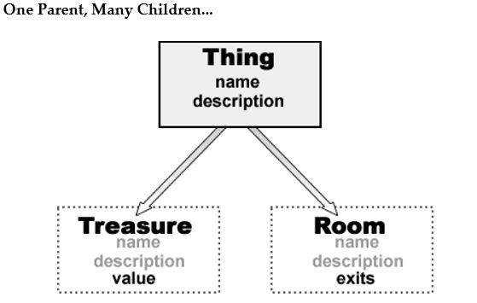
Cont..
The name and description variables are the assigned values in the initialize method when a new Thing object is created.

Slide 9
Cont..
The methods that are in build in an ancestor class are:
get_name
set_name
get_description
set_description
The methods are called using the Super keyword like super(aName, aDescription)

Slide 10
Cont..
Example:
# This passes a, b, c to the superclass
def initialize( a, b, c, d, e, f )
super( a, b, c )
end
# This passes a, b, c to the superclass
def initialize( a, b, c )
super
end
# This passes no arguments to the superclass
def initialize( a, b, c)
super()
end

Slide 11
Strings
Let’s start off with an example to understand it better:
print('Enter your name: ' )
name = gets()
puts( "Hello #{name}" )
The double quoted strings can be replaced by %Q and / or %/ and /
For single quoted strings, it can be replaced with %q and /
Example: puts %Q/Hello #{name}/
String Handling
Concatenation:
You can concatenate strings using << or + or just by placing a space between them.
Example:
s = "Hello " << "world“
s = "Hello " + "world“
s = "Hello " "world"

Slide 12
Cont..
Format Strings:
%d – decimal number
%f – floating point number
%o – octal number
%p – inspect object
%s – string
%x – hexadecimal number
Example: printf( “%0.02f”, 10.12945 )
# displays 10.13

Slide 13
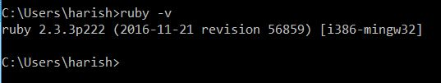
Installation Process
Download the latest Ruby from http://rubyinstaller.org/downloads/
After installing it, open cmd and type ruby –v
As in the above figure, it shows the latest version of the Ruby installed.
After the development kit is installed, the following 2 commands are executed:
1 ruby dk.rb init
2 ruby dk.rb install

Slide 14
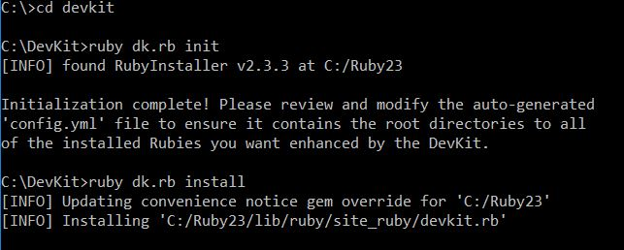
CONt..

Slide 15
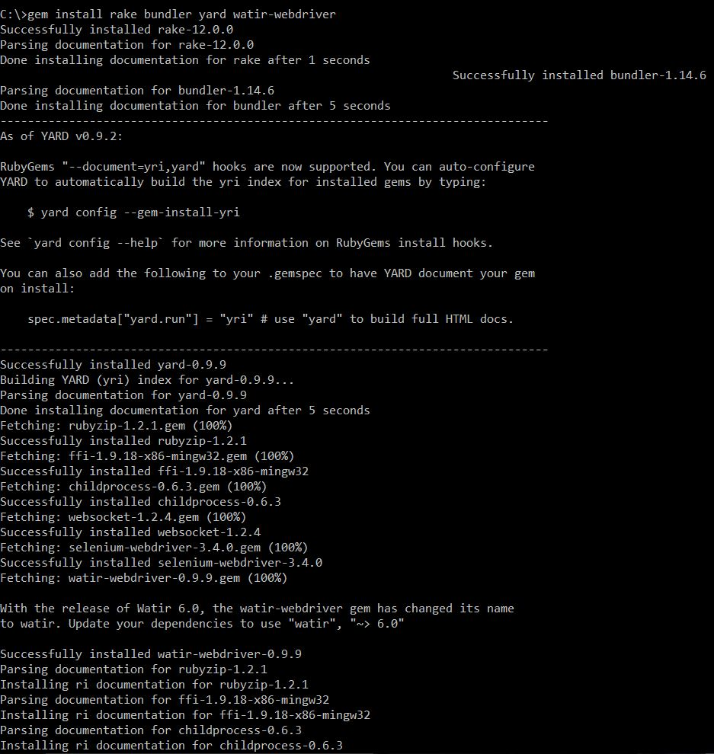
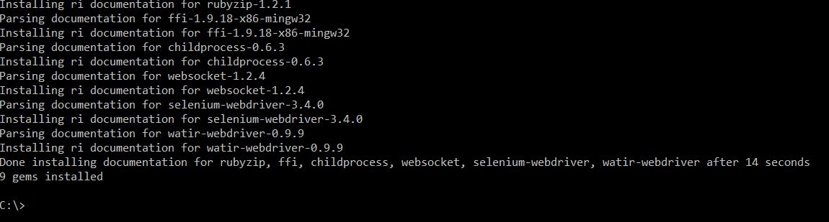
Installing Ruby Gems
To install the gems the below command is to be executed in the command prompt:
gem install rake bundler yard watir-webdriver

Slide 16
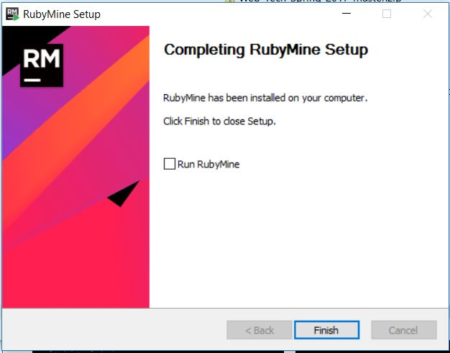
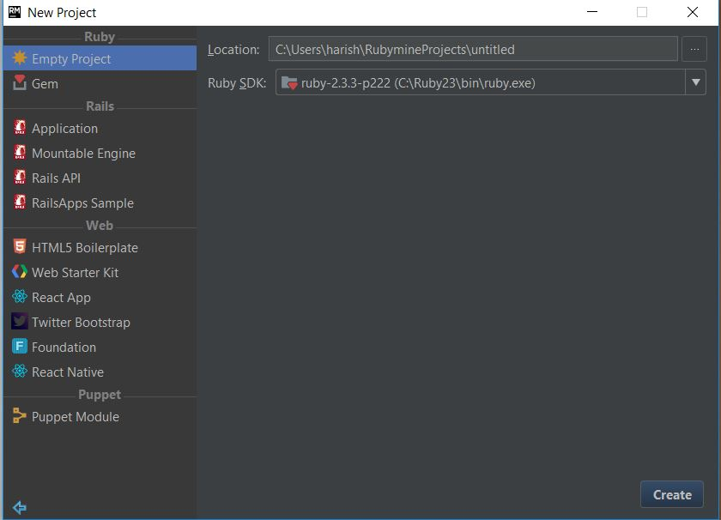
Installing RubyMine Editor
Install RubyMine that is an editor on which the ruby code is written.

Slide 17
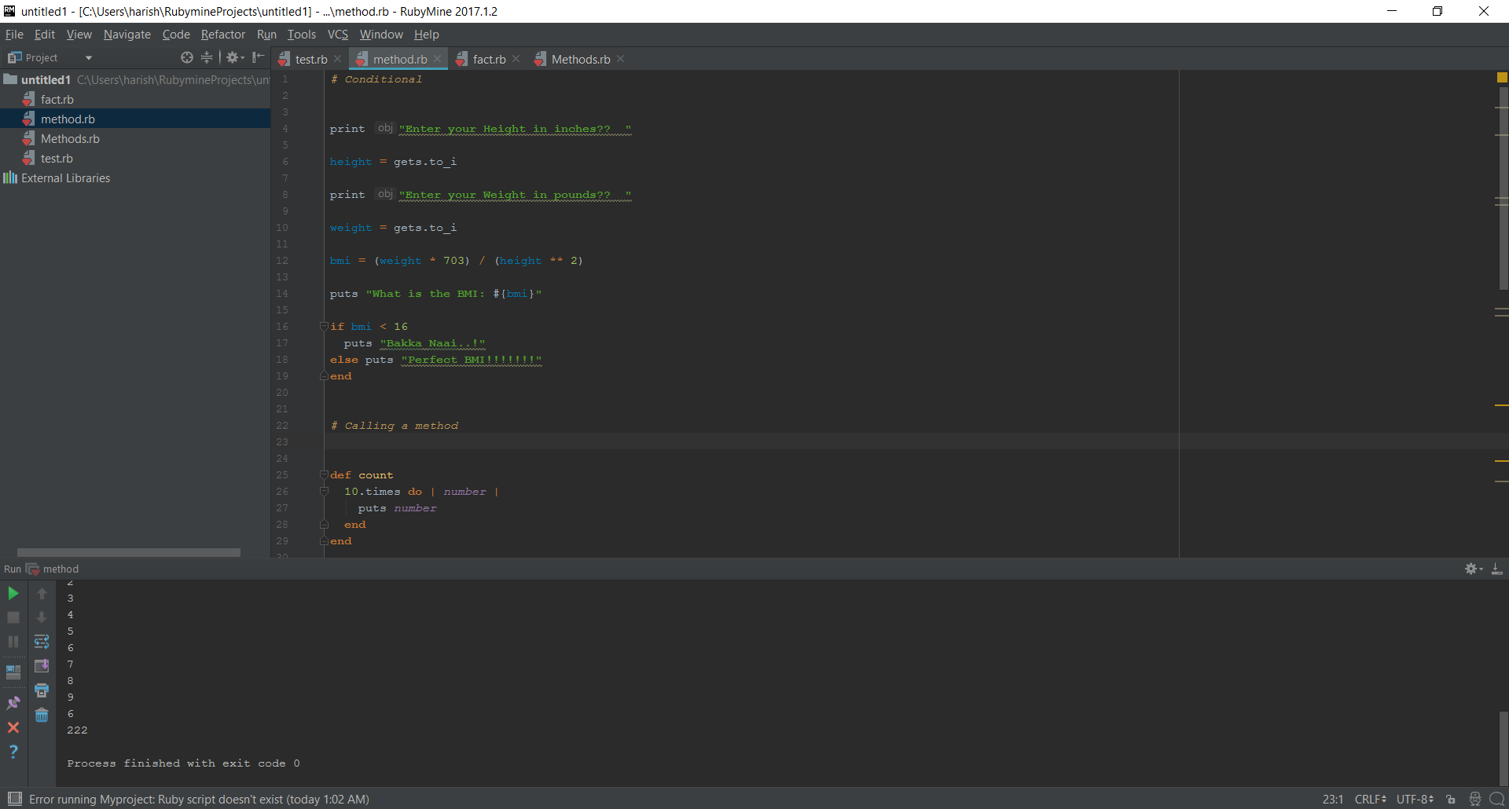
Script Demo

Slide 18
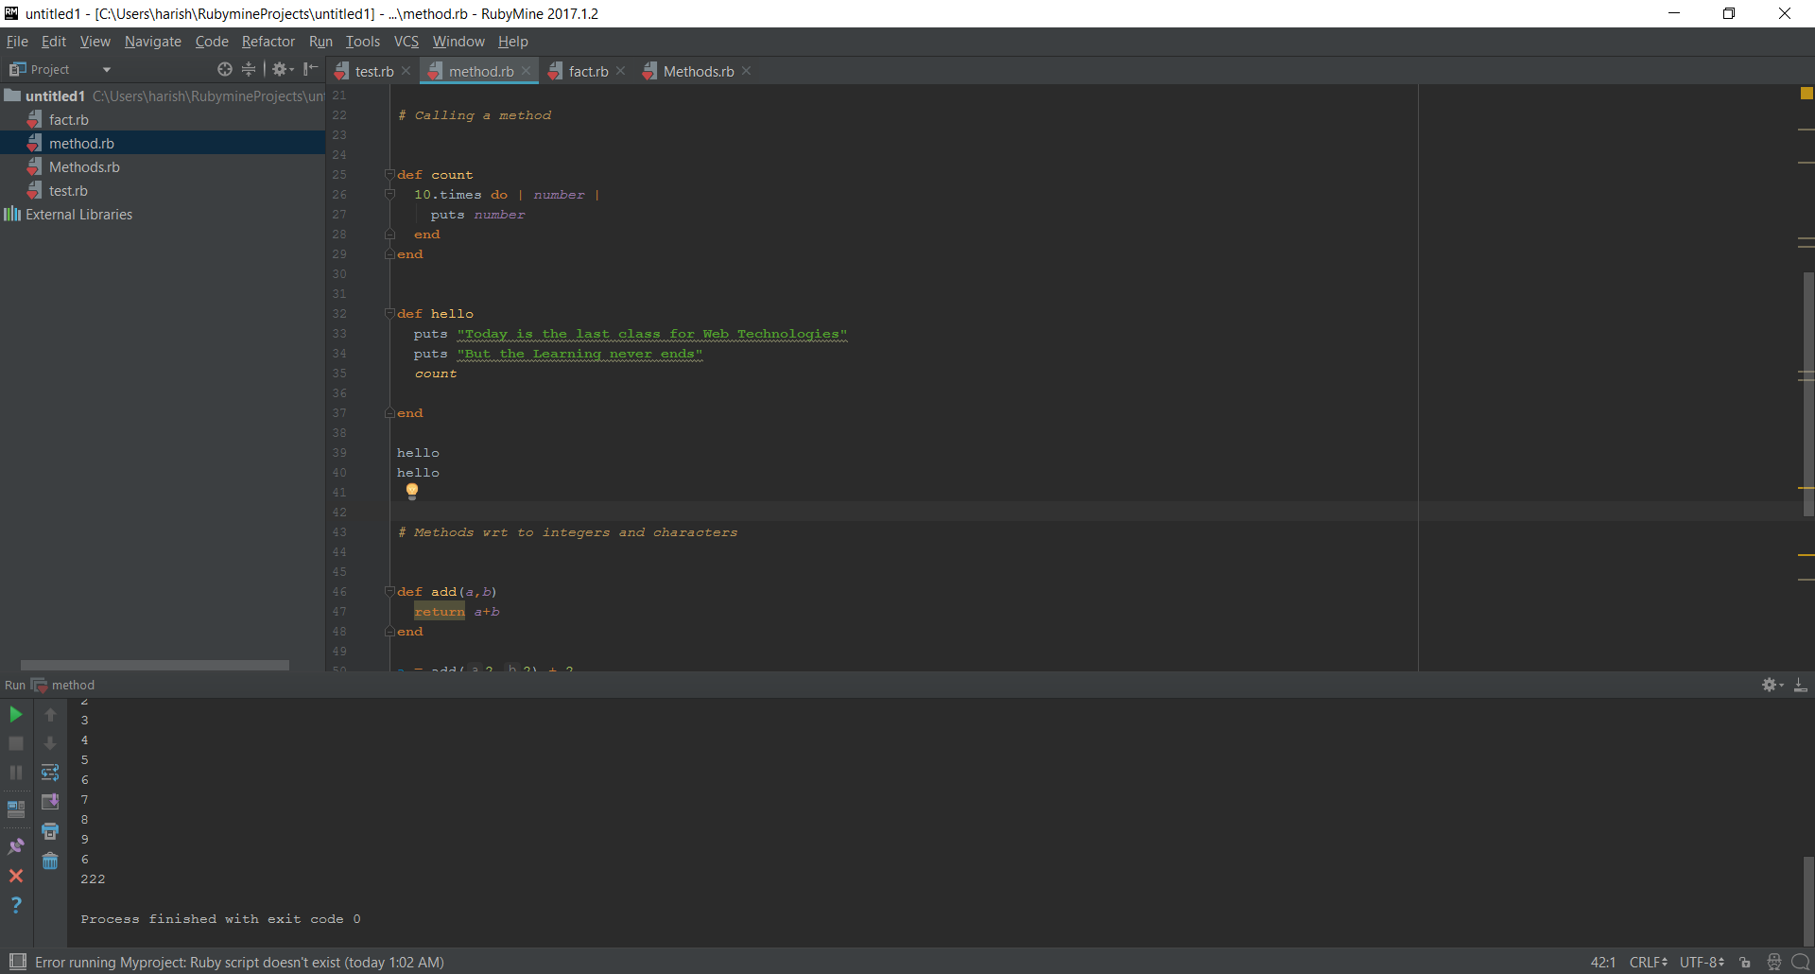
Cont..

Slide 19
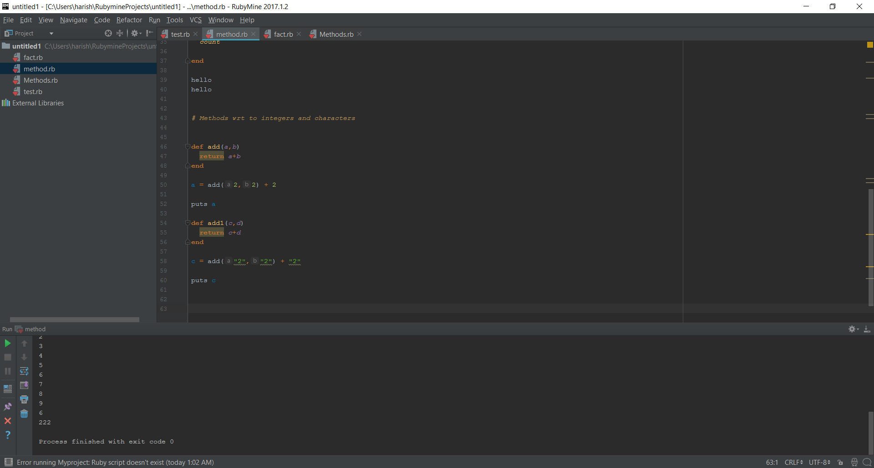
Cont..

Slide 20
Pros of Ruby on Rails
Quality of the code
Test Automation
Large Community
Responsible Developers
Productivity

Slide 21
References
Cucumber & Cheese A Testers Workshop Jeff Morgan
THE BOOK OF RUBY by HUW COLLINGBOURNE
https://www.youtube.com/watch?v=A6cRzt8_oBg&list=PLSXDqiI4sC5NinJXEoYH6FYQ7vtIO8IPF&index=15

Slide 22
Thank You ☺ ☺ ☺

